Slide 1
Cloud Native - Runtimes and Frameworks —

Slide 2
Evolution of the App Platform
Applications
J2EE or .Net
Cloud Native (container, microservices, DevOps, CI/CD)
Platform
Open Standards
Open Source
Private Datacenter
Physical/Virtual Servers
Public Cloud
Virtual Private Cloud
Private Cloud
Infrastructure
circa 1999
circa 2020

Slide 3
Tradeoffs in Application Design
Application Requirements
Stateful & Stateless
Events & Requests
Simple & Flexible
Platform

Slide 4
Runtime and frameworks
Runtime is a platform for executing commands
For e.g.
JRE, (a Java runtime environment)
Node.js (a JavaScript runtime environment)
Do not enforce any development patterns
A framework focuses more on best practices
Frameworks are typically opinionated, designed to produce predictable outcomes.
For e.g. Spring Framework (An opinionated way to create a web server that runs on the java runtime)
Frameworks are often used to fill knowledge gaps
Simply make developers more efficient by providing reliable/predictable outcomes.

Slide 5
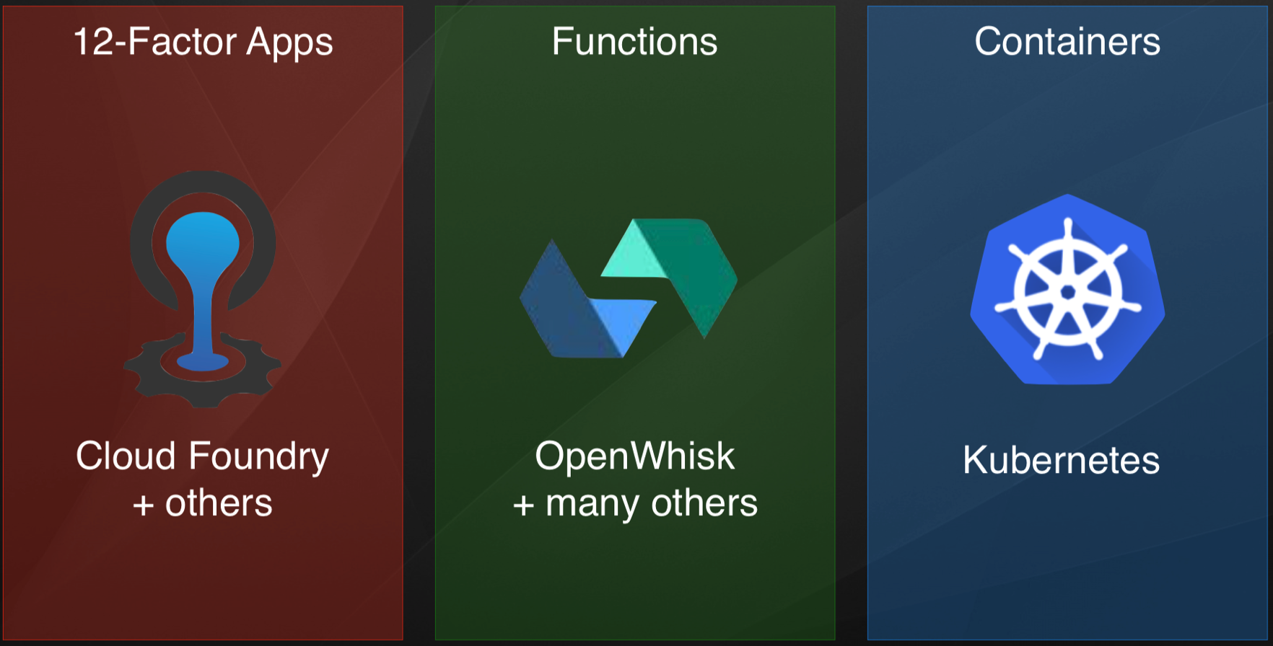
Three stacks for three styles for their runtimes..
Container Runtime

Slide 6
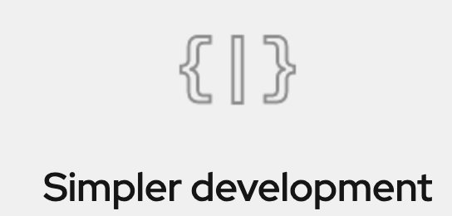
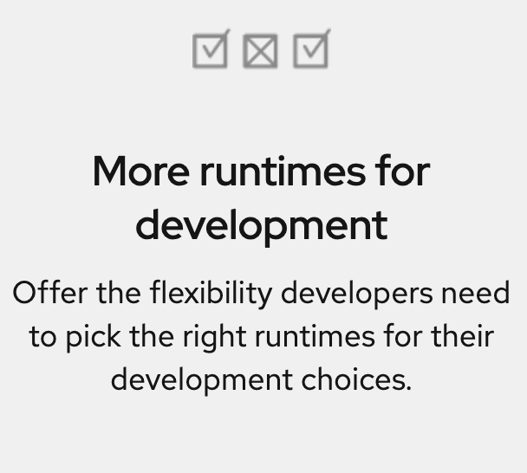
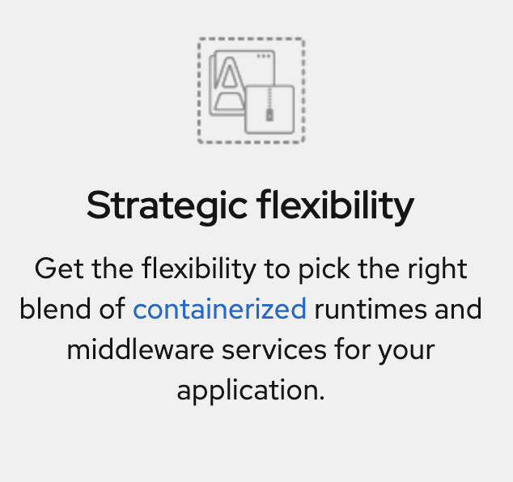
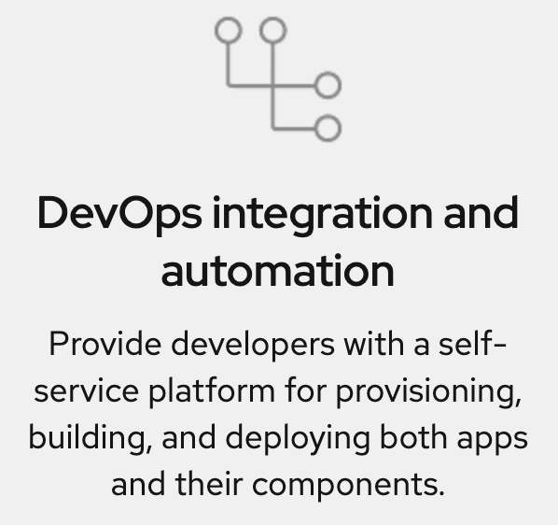
Runtimes & Frameworks – Features, Benefits & why
Integrate the capabilities of programming model of multiple runtimes.
Cloud-native development - simpler and more flexible
Needs portability across multiple cloud infrastructures -> allowing the developer to use microservices, containers, and DevOps automation.
Build new apps—faster than ever

Slide 7
Infrastructure as Code (IaC)
Infrastructure as code (IaC) - means to provision & manage your IT infrastructure using configuration / scripts files written in code.
Scripting / Imperative Creating infrastructure by writing scripts - End state to be reached line by line, i.e recipe ex: shell / bash
Declarative Creating infrastructure by writing declarative code, not controlled by the flow of code - End state is important & now how to reach end-state ex: CloudFormation, Terraform
Example: (step by step to reach end state) ibmcloud cli create K8s ibmcloud cli create VM ibmcloud cli create VPC
Example: (end state) K8s resource -> host:--.--.--.— -> port: -- VM resources -> domain: --.--
VPN resources -> subnets: --.--.--.-- -> IP: --.--.--.--

Slide 8
Spring Boot – What ?
Firstly, Spring boot is not a framework & Spring framework has been around.
It’s an approach to develop spring application with less configuration.
It is easy to learn when you know spring framework, it developed on top of existing spring framework.
It’s an innovation of spring team.
It is open source.

Slide 9
History of Spring Framework
1999 J2EE 1.2
2001 xDoclet 1.0
2004 Spring Framework 1.0
2006 Java EE 5
2013 Spring Boot

Slide 10
Spring Framework
Spring is one of the most widely used Java EE Frameworks for building applications.
One of the major features of the Spring framework is the dependency injection. It helps make things simpler by allowing us to develop loosely coupled applications.
• The Spring framework can be used for all layers of implementation in the development of
an application. It supports declarative programming.
• Considering its POJO model, it is a very lightweight framework.
• It allows loose coupling and easy testability.
• • It is capable of eliminating the formation of singleton and factory classes.
• It supports both XML and annotation configurations.
• It provides middleware services.

Slide 11
Why Spring Boot?
Easy to developed spring-based application with java - Spring Boot doesn’t require you to deploy WAR files.
It aims to reduce the IOC (DI – Dependency Injection). It reduce lots of development time and increase productivity.
Avoid writing boilerplate code, annotation and xml configuration
Easy to integrate with spring ecosystem like jdbc, security, orm, data etc.
It follows opinionated default configuration to spring development
It provide CLI tool to developed and test spring boot. It simplifies Spring dependencies and runs applications straight from a command line.
Use Maven and Gradle to build application easily
It offers production ready features.

Slide 12
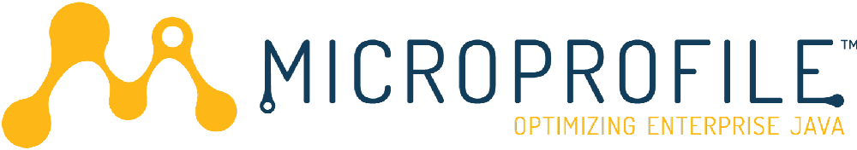
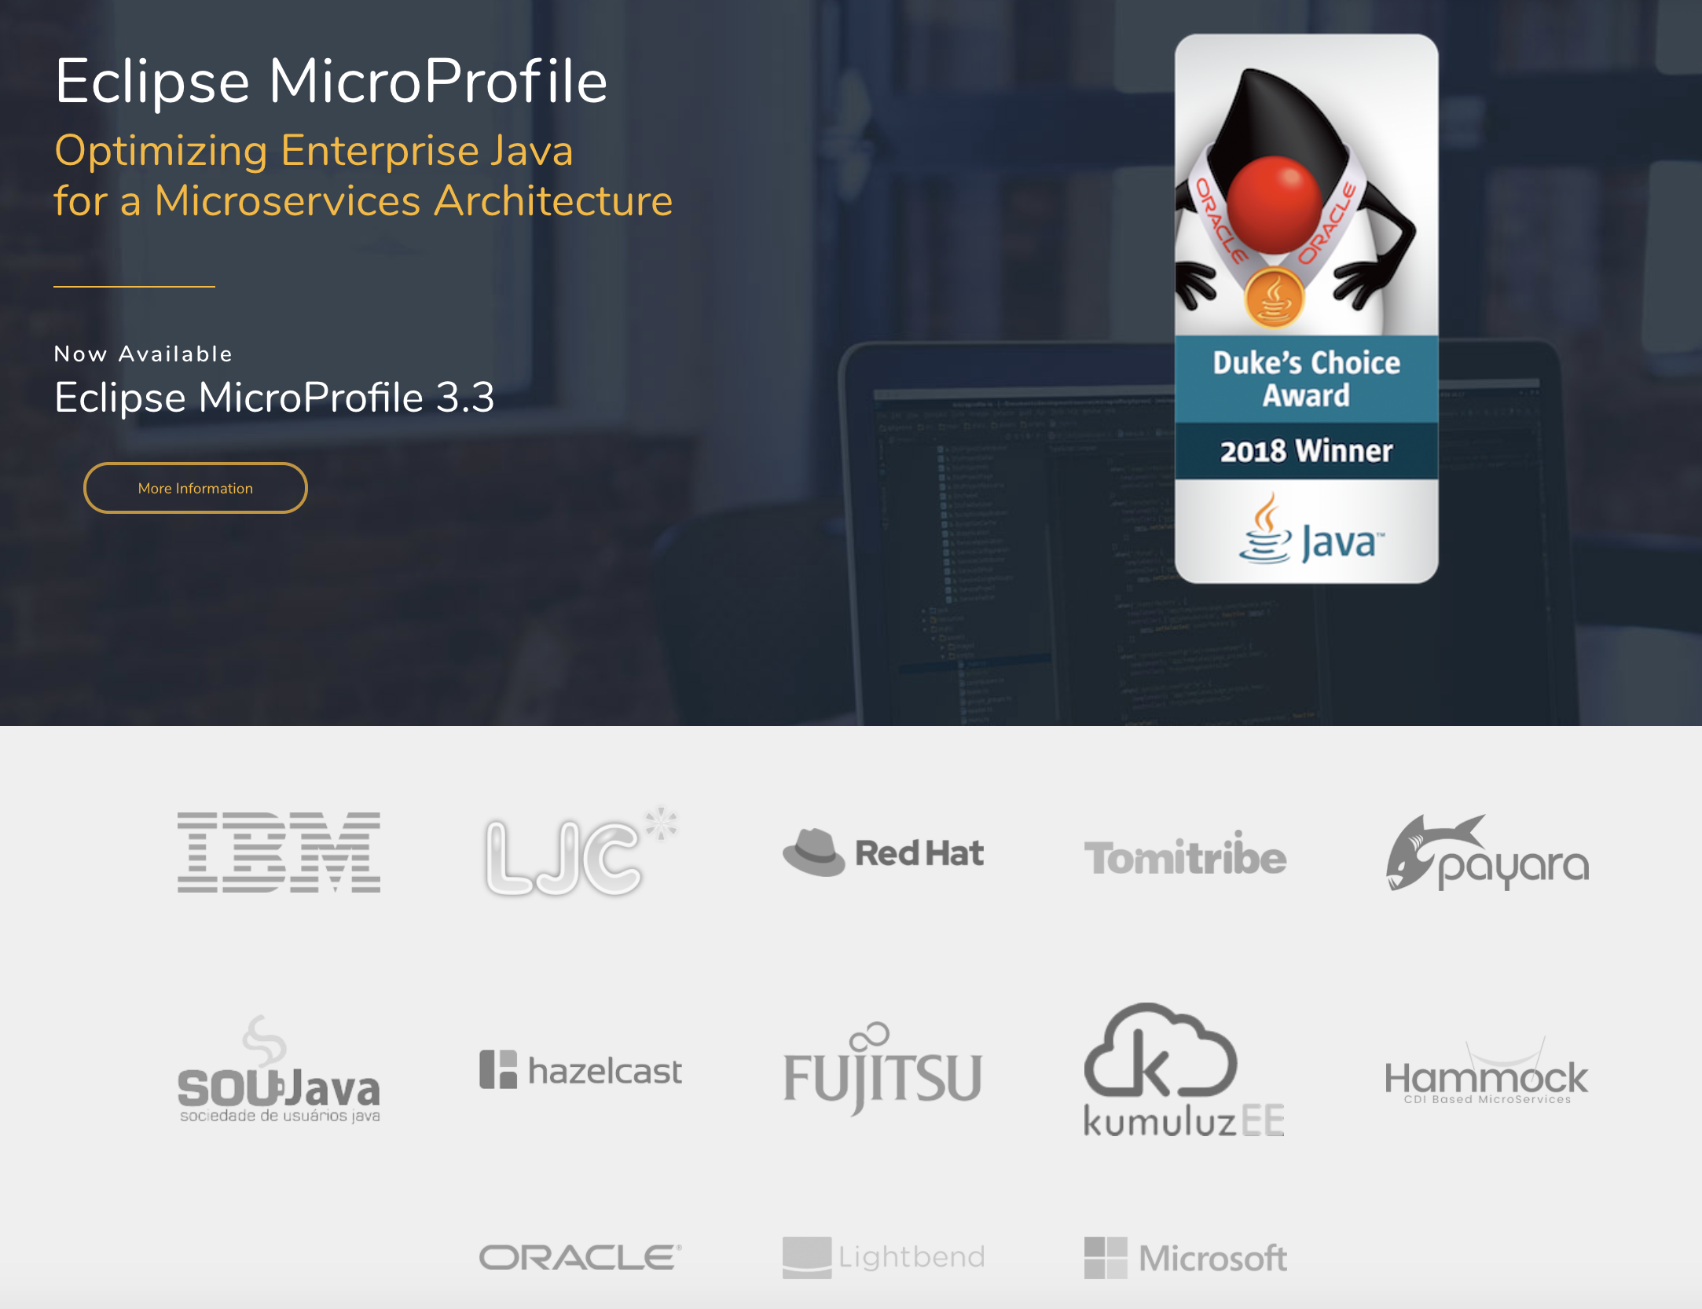
MicroProfile
Optimizing Enterprise Java
for a MicroService Architecture
http://microprofile.io/
Project @ Eclipse Foundation
Open Source (Eclipse)
Enterprise Java for Microservices
Builds on Java EE standards

Slide 13
Need for Eclipse MicroProfile
With the Java EE full profile becoming so large, over 30 APIs at the last count, it doesn’t seem right to include all those specifications when you are building something that you call ‘micro’,
Not going to use the vast majority of those Java EE APIs
The space was becoming fragmented, with each vendor implementing their own opinion about the right way to do microservices

Slide 14
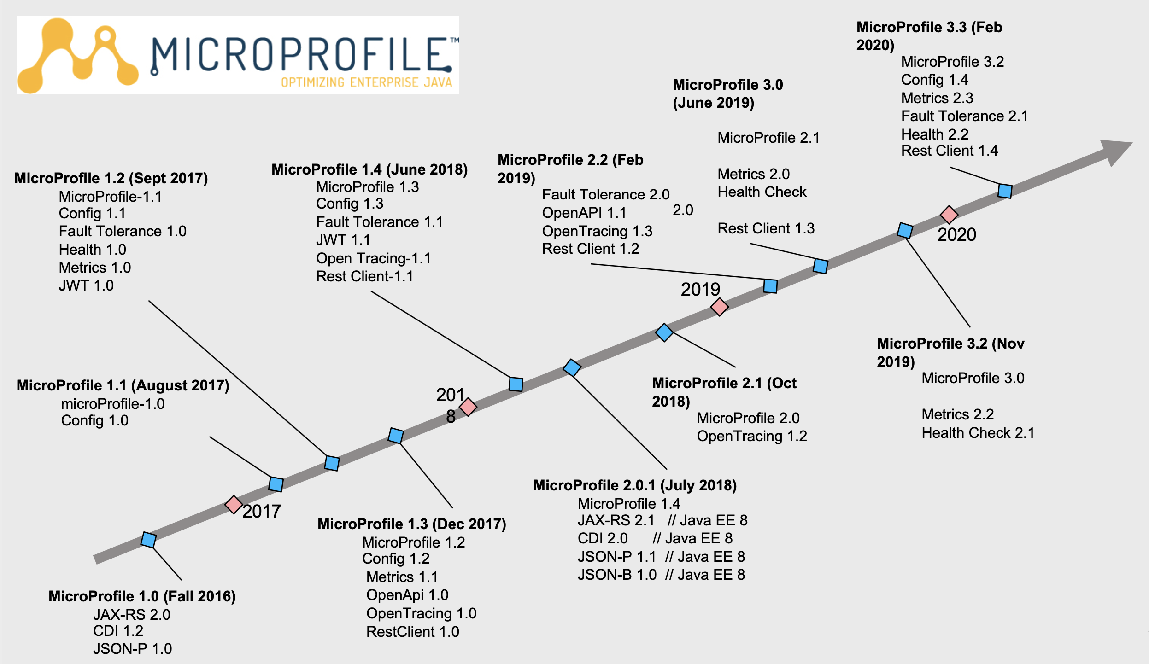

Slide 15
Best combination of platform, runtimes, and tools for Cloud Native development
IBM Cloud Pak for Applications What is “OpenShift plus enterprise runtimes plus enterprise runtimes and accelerators for teams”?
OpenShift plus WebSphere portfolio and RH Runtimes and accelerators for teams
Accelerators for Teams
Derived from Kabanero.io open source
Open source cloud native development - empowering teams to start quicker with increased productivity
WebSphere Portfolio
WAS (Base), WAS Liberty Core, Open Liberty, Node.js with Express and Loopback, Mobile Foundation…and more
Red Hat Runtimes
JBoss EAP, JBoss Web Server, Node.js, Vert.x, Thorntail, Spring Boot (Tomcat)…and more
Red Hat OpenShift Container Platform
No functional restrictions
Kubernetes for the Enterprise, designed to power business transformation and unite development teams on a single platform

Slide 16


Cloud Pak for Applications: what you need today, what you need tomorrow
Build new cloud-native apps
ACCELERATORS FOR TEAMS & ENTERPRISE GOVERNANCE
Equipping teams with content, tools, architectures and methods so they can focus on business problems from day 1
Red Hat CodeReady Workspaces
Collaborative OpenShift-native IDE
Red Hat Runtimes
WebSphere
Java/Jakarta EE
Open Liberty, JBoss EAP
Java SE
OpenJDK
Java Web
JBoss WS
Traditional
WebSphere
Javascript
Node.js
Spring
Spring Boot
Serverless
Cloud Functions
Liberty
MicroProfile
Open Liberty , Thorntail
Reactive
Vert.x
Java.next
Quarkus
Distributed Data
Data Grid
Messaging
AMQ Broker
Mobile Foundation
SECURITY
SSO
Red Hat OpenShift Container Platform

Slide 17
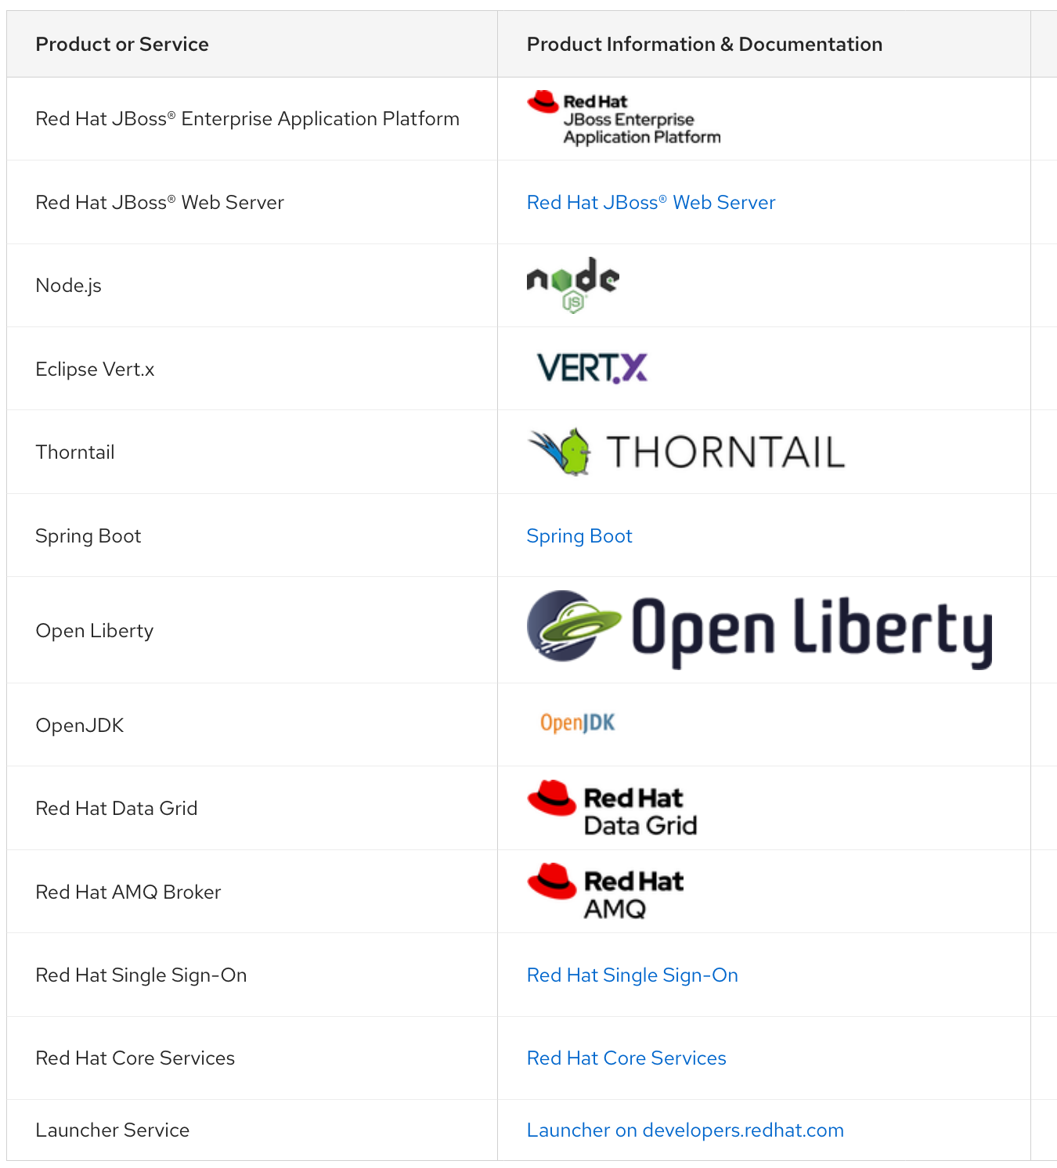
Cloud Pak for Apps Components:
Red Hat Runtimes
Red Hat Runtimes provides a set of open runtimes, tools, and components for developing and maintaining cloud-native applications. It offers lightweight runtimes and frameworks for highly distributed cloud architectures, such as microservices.
https://access.redhat.com/articles/4394291

Slide 18
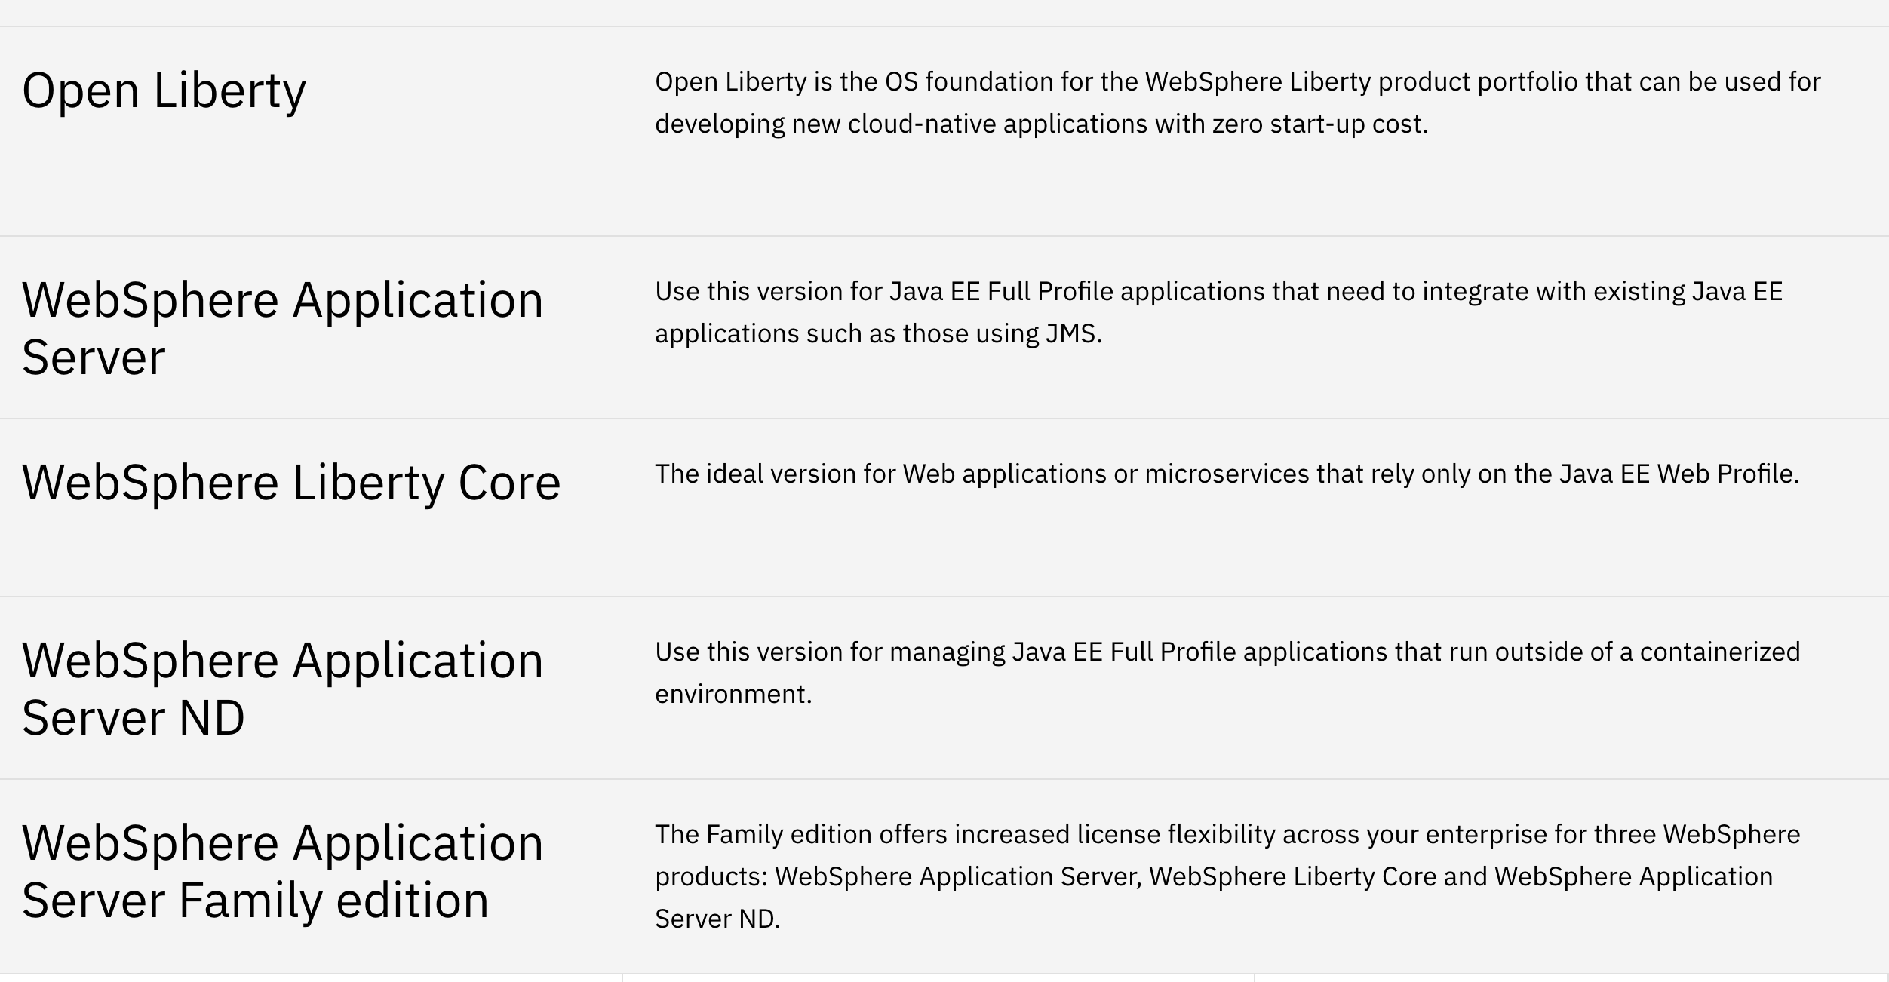
IBM WebSphere Liberty

Slide 19
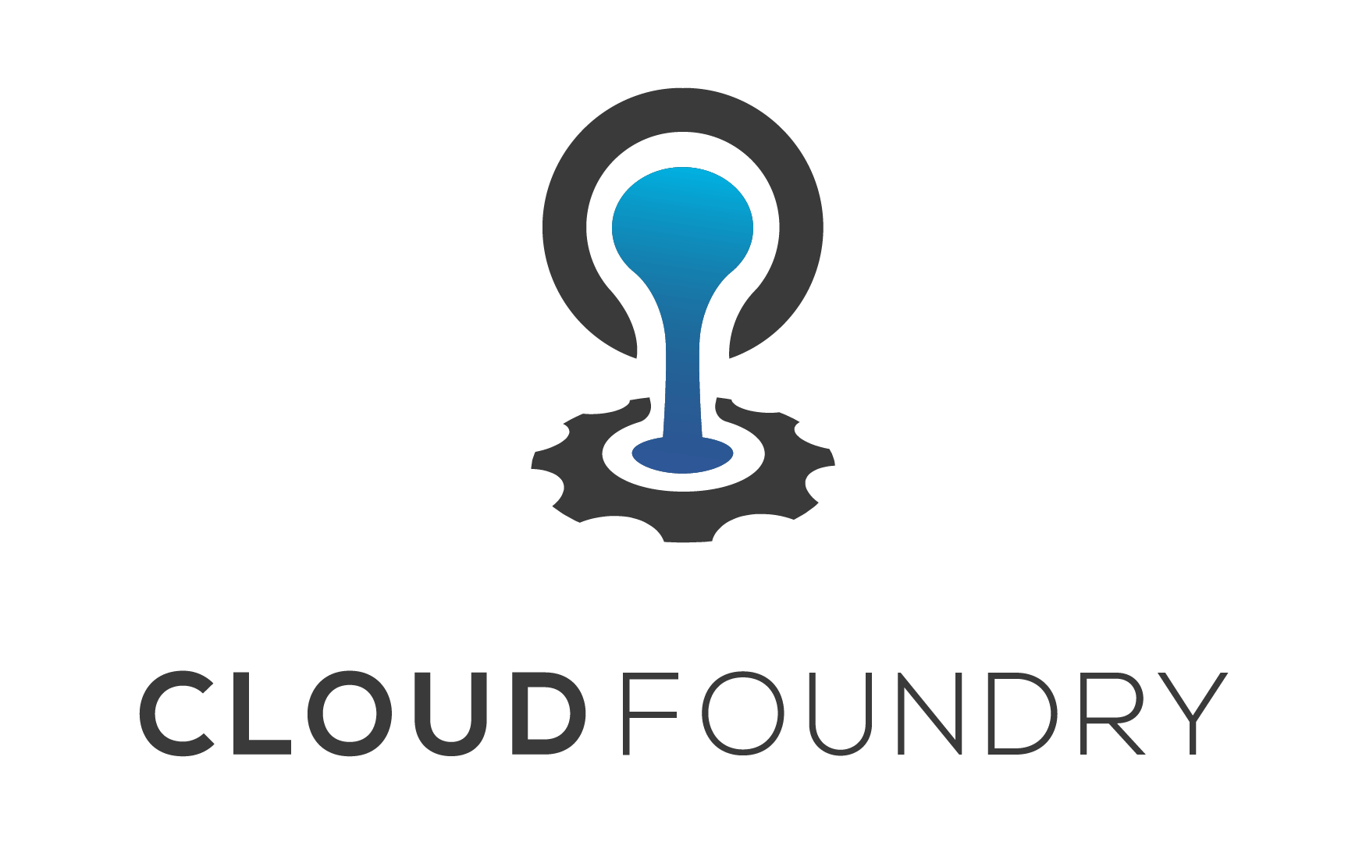
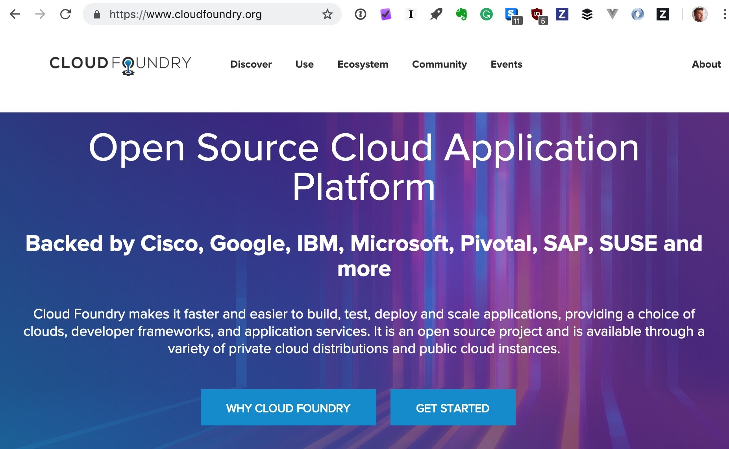
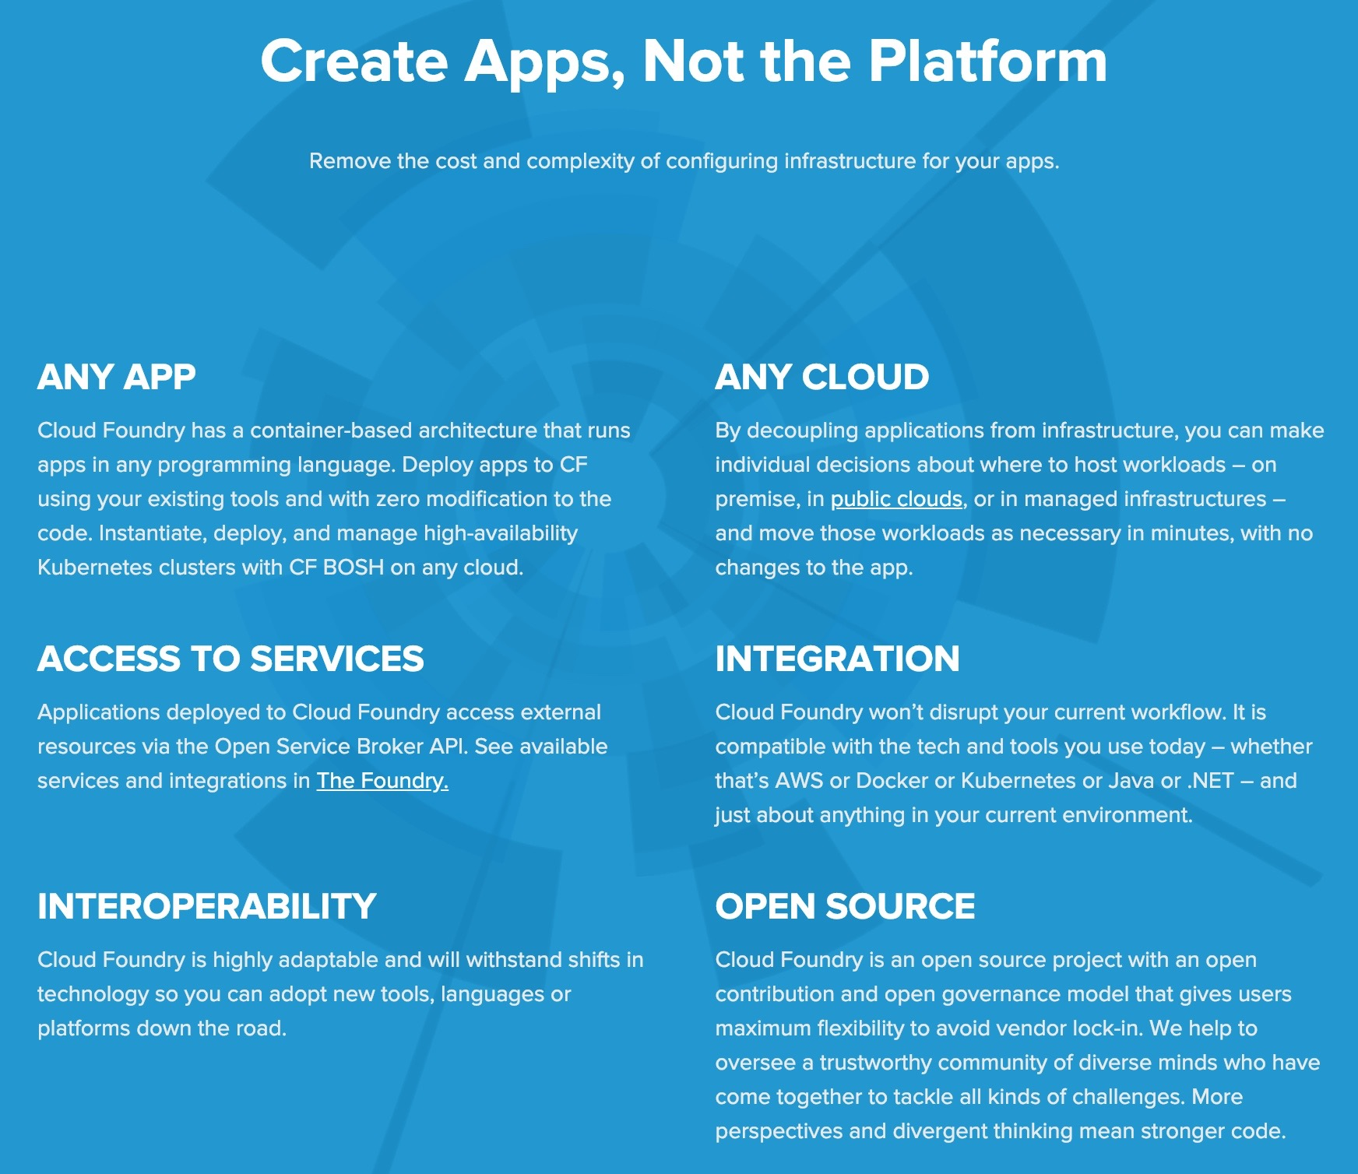
IBM Cloud Foundry
”Here is my source code
Run it on the cloud for me
I do not care how”
*click here*
Notes:
IBM Cloud™ Foundry includes runtimes for Java, Node.js, PHP, Python, Ruby, Swift and Go; plus, Cloud Foundry community build packs are also available Automatic routing High availability Access control Platform-as-a-Service (PaaS), that ensures the fastest, easiest, and most reliable deployment of cloud-native applications. Combined with DevOps services, the application runtimes enable a delivery pipeline that automates much of the iterative development process.

Slide 20
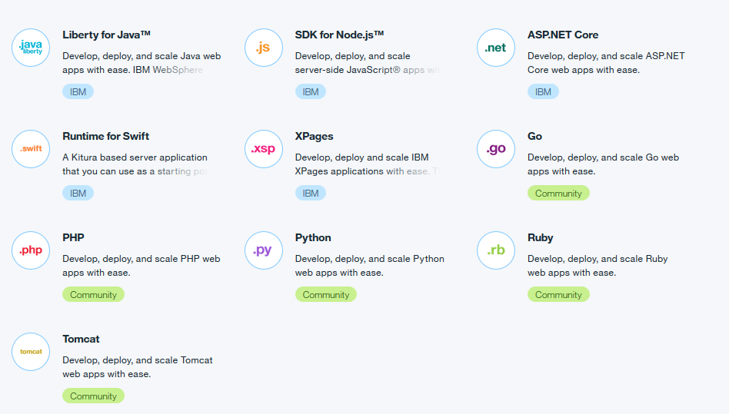
Application runtimes and buildpacks
Cloud Foundry Buildpacks
specific runtime
build framework
types on IBM Cloud
IBM
Cloud Foundry Community
External (bring your own!)
Notes:
IBM Cloud Foundry application runtimes are provided through buildpacks. A buildpack is a collection of scripts that prepare your code for execution on the target PaaS. A buildpack gathers the runtime and framework dependencies of an application. Then, it packages them with the application into a droplet that can be deployed to the cloud.
The IBM Cloud catalog has a number of runtimes available through the Cloud Foundry apps section of the catalog. These runtimes come in different types. There are IBM provided and supported runtimes (blue IBM logo on the runtime tile), there are Community buildpacks from the Cloud Foundry open source community (green Community logo on the runtime tile). Both of these are installed and ready for you to use with an application. For other languages and runtimes, you can specify your own buildpack/runtime when using the CLI to push an application. More on that in just a bit.

Slide 21
Buildpacks provide support for a language runtime
Buildpack
collection of scripts
app framework dependencies
prepares runtime
packages application into a droplet for deployment
Automatically selected
Simplifies Cloud deployment – just provide your application code
Notes:
Buildpack - A buildpack is a collection of scripts that prepare your code for execution on the target PaaS.
A buildpack gathers the runtime and framework dependencies of an application.
Then, it packages them with the application into a droplet that can be deployed to the cloud. The diagram depicts the deployment of an application to a container running with the Cloud Foundry architecture. Bluemix is currently running the Diego version of Cloud Foundry.
Buildpacks are automatically selected when the application is staged for deployment
The buildpack model addresses the complexity of runtime composition for modern applications. By collecting and configuring the runtime executable as a logic units, the buildpack simplifies the process for deploying cloud applications.

Slide 22
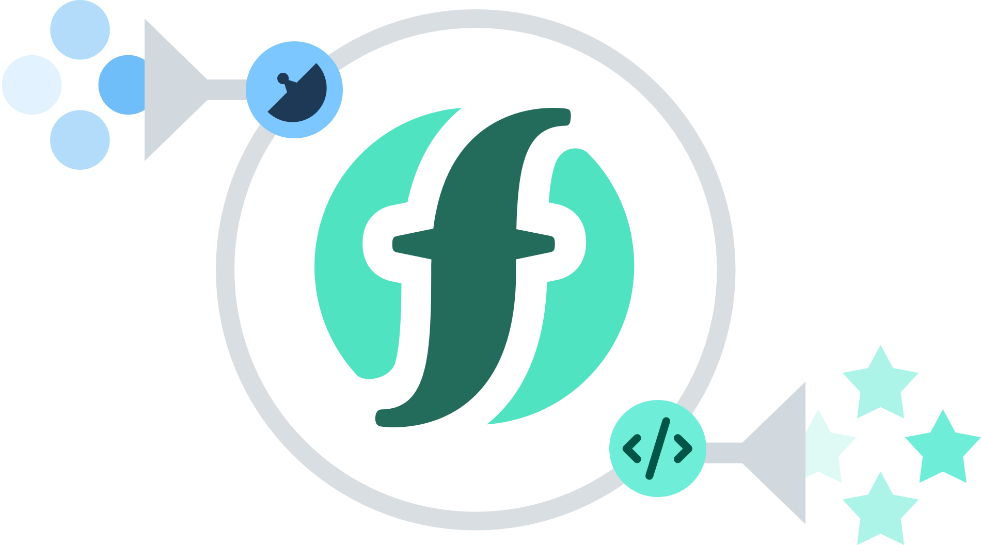
SERVERLESS COMPUTING
What is Serverless? “Focus on your application & code, not the infrastructure” “backend as a service”
https://readwrite.com/2018/06/04/the-future-of-e-commerce/

Slide 23

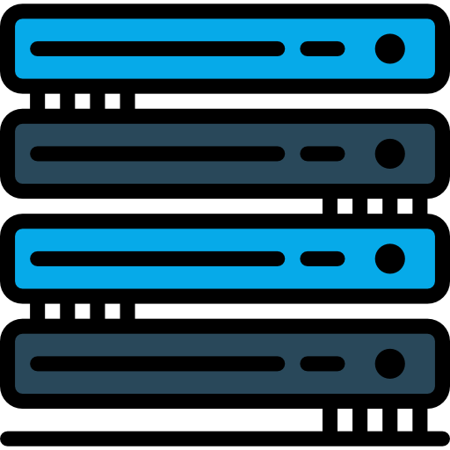

Traditionally, we built our applications and controlled how they can communicate with a server. A server that we are managing and provisioning for. There are some issues that arose though.
SERVERLESS COMPUTING
DOC ID / Month XX, 2018 / © 2018 IBM Corporation

Slide 24
What is Serverless Computing | Functions as a service (FaaS)?
SERVERLESS COMPUTING
1. Requires no management and operation of infrastructure, enabling developers to focus more narrowly on code/custom business logic.
2. It’s a computing service runs code only on-demand on a per-request basis, scaling transparently with the number of requests being served (event-based)
3. $$ Enables end users to pay only for resources being used, never paying for idle capacity.
https://cloud.ibm.com/functions/

Slide 25
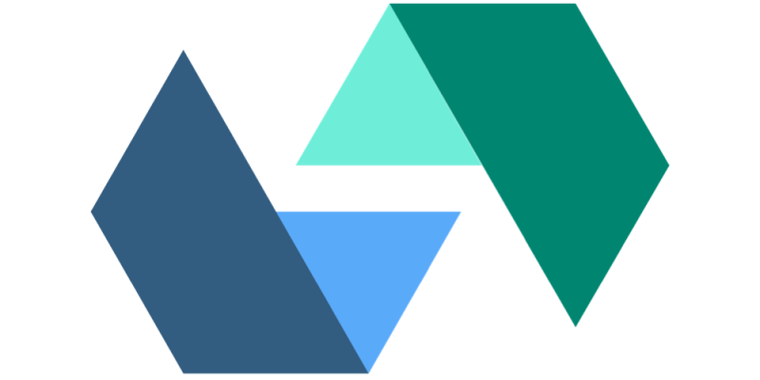
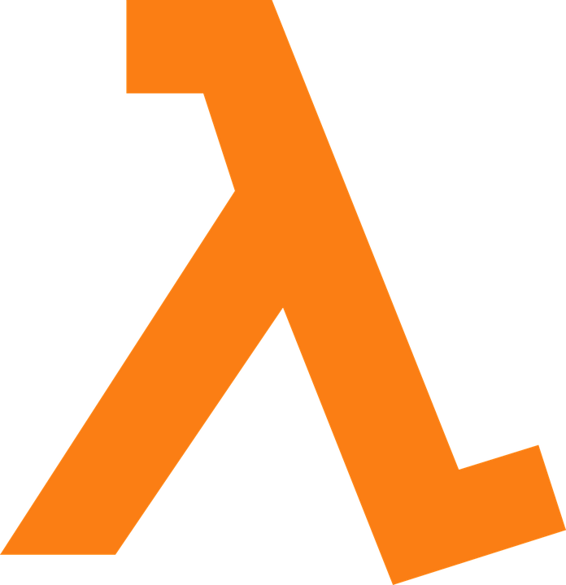
Serverless Computing
SERVERLESS COMPUTING
IBM Cloud Functions
Does not refer to a specific technology.
Apache OpenWhisk
IBM’s Cloud Functions started as the OpenWhisk research project at the IBM Watson Research center
AWS Lambda
Azure Functions
Notes:
In 2014, Lambda Apache OpenWhisk (IBM Cloud Functions)
Kubeless
Fn (Oracle Serverless)

Slide 26
Backend as a Service progression
SERVERLESS COMPUTING
IaaS | CaaS | PaaS | FaaS/Serverless
Functions | Functions | Functions | Functions
Applications | Application | Applications | Applications
Runtimes | Runtimes | Runtimes | Runtimes
Operating Systems | Operating Systems | Operating Systems | Operating Systems
Infrastructure | Infrastructure | Infrastructure | Infrastructure
Provided by Developer
Virtualization
Provided by Cloud

Slide 27
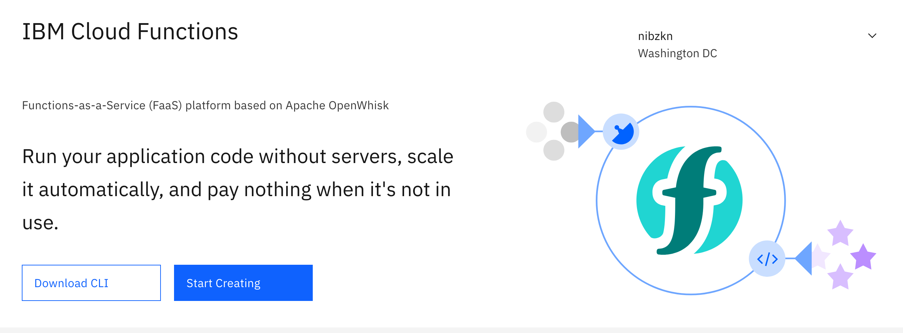
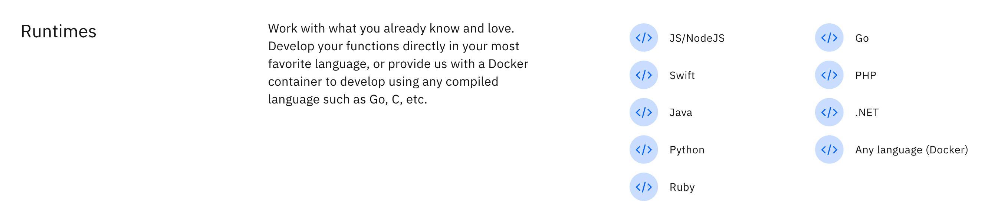
IBM Cloud Functions - Runtimes

Slide 28


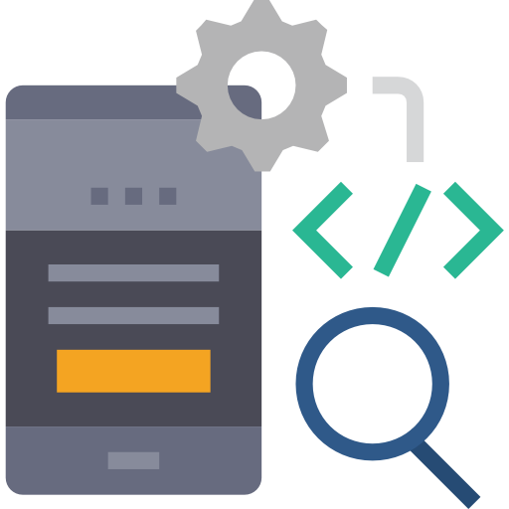
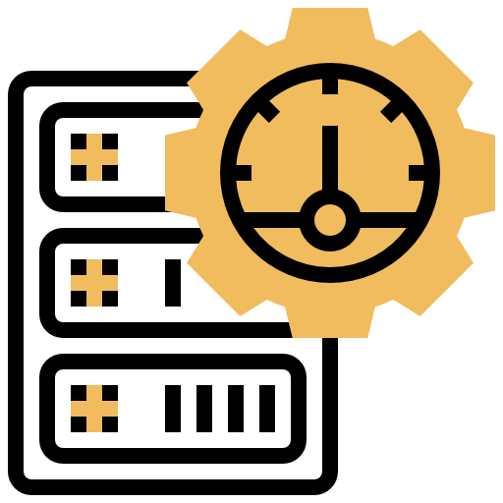
SERVERLESS COMPUTING
Responsibilities with traditional servers
- Costs
- Maintenance
- Scaling up and down according to the application usage

Slide 29
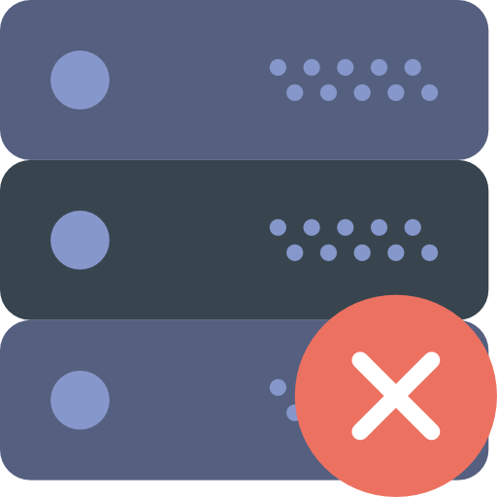
Serverless Computing
SERVERLESS COMPUTING
Cost Effective Computing
Low maintenance
Serverless computing refers to a model where the existence of servers is entirely abstracted away.
Easy to scale

Slide 30

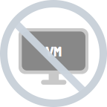
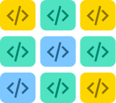

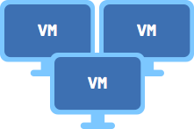

What is Serverless computing (Functions-as-a-Service)?
SERVERLESS COMPUTING
Functions
Containers / PaaS
Increasing focus on business logic
Virtual machines
Bare Metal
Decreasing concern (and control) over stack implementation
Notes:
Following increasing abstraction away from bare metal over the years, new serverless platforms like OpenWhisk and Amazon Lambda enable developers to focus more on their key business logic—written as ever smaller pieces of code, or functions — rather than its supporting infrastructure.

Slide 31
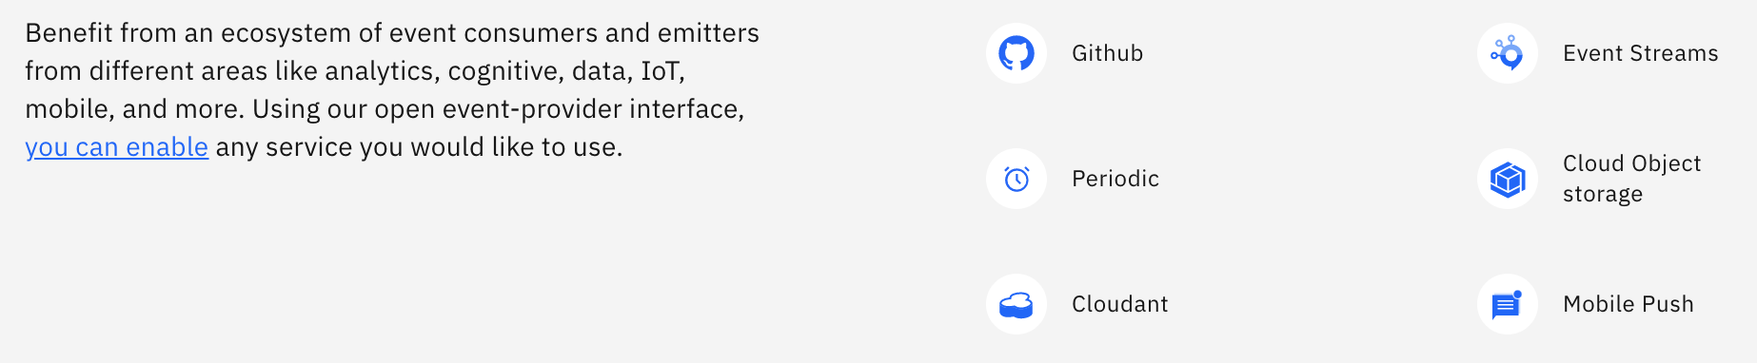
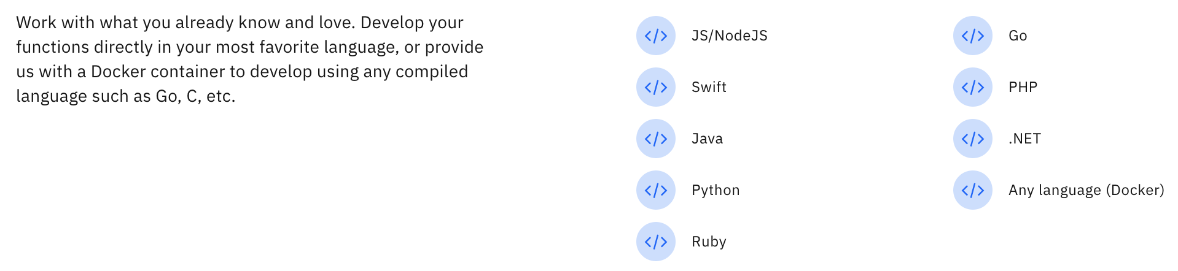
SERVERLESS COMPUTING
Event Providers..
Runtimes..

Slide 32
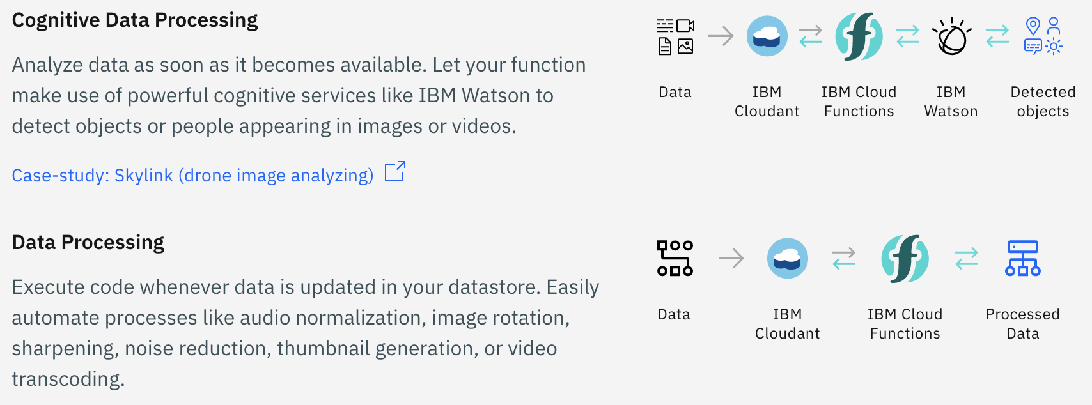
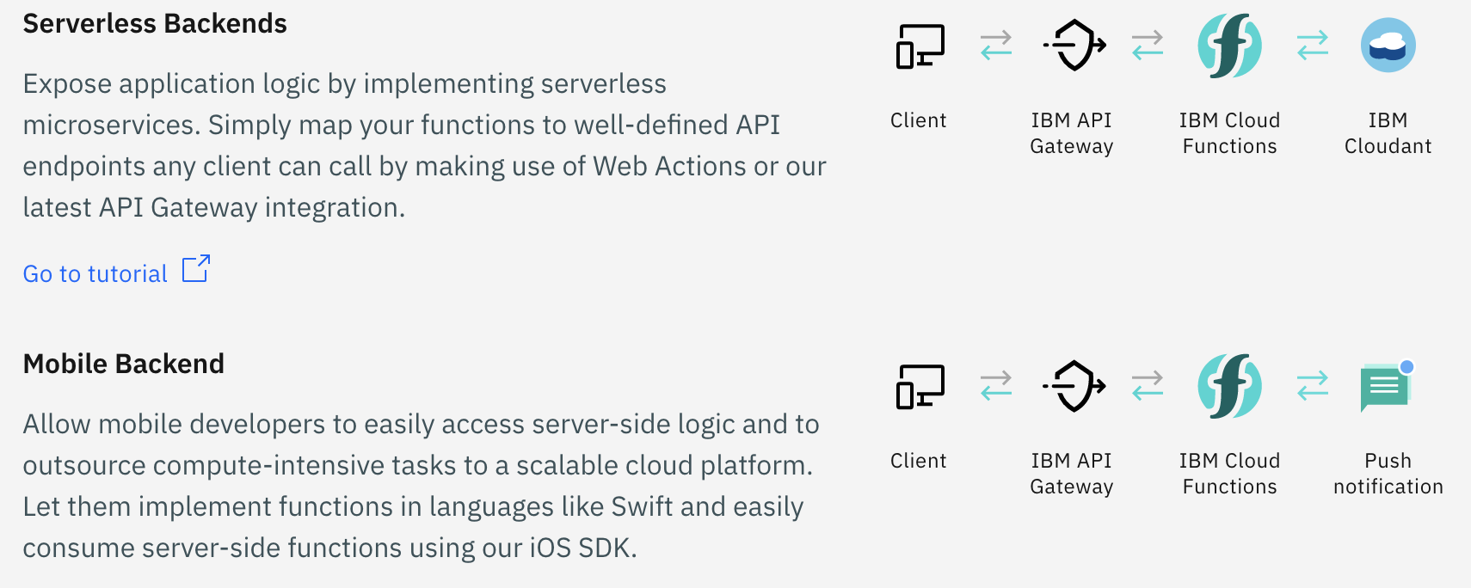
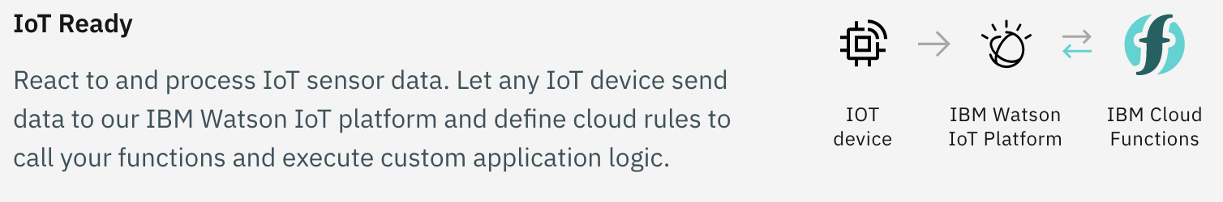
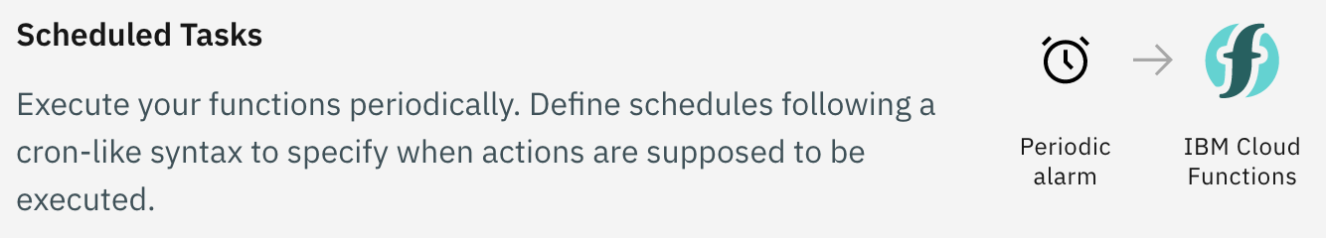
What can I use Cloud functions for ?
SERVERLESS COMPUTING

Slide 33
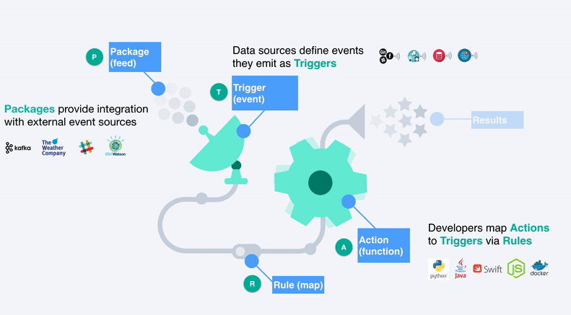
In a Nut-shell
SERVERLESS COMPUTING

